Slide 1
JOURNEY PRESENTATION
AKSHAY P

Slide 2
Day 1 – Data Fundamentals and case study
•We were given a case study combining everything we had learned the past week.
•We were asked to improve S/W Processes through dev-ops and then automate testing of their Java application.
•Created an Azure Dev-ops project and assigning different tasks , epics , sprints for the development process.
•Forked a GitHub Repository and connected to a local machine.
•Created an Azure VM and connected to it using an online environment.
•Downloaded and installed latest version of Maven into the VM created.
•Created a Docker file for the Java Spring Boot Application.
•Configured Azure Web App and set up GitHub actions workflow.
Some of the most used DML commands:
SELECT – fetch data from the database. It’s one of the most popular commands, as every request begins with a select query.
AND – combine data from one or more tables.
CREATE – build different tables and specify the name of each column within.
UPDATE – modify existing rows in a table.
NSERT – add new data or rows to an existing table.
WHERE – filter data and get its value based on a set condition

Slide 3
Day 2 – normalization and big data
We learned about the fundamentals of data.
We were given a brief overview about the different types of data and how they are represented.
We were also given a brief understanding of DBMS and did a case study with the help of an ER diagram.
Normalization is a process to reduce the redundancy and anomalies in a relational database.
Advantages of Normalization
Normalization helps to minimize data redundancy.
Greater overall database organization.
Data consistency within the database.
Much more flexible database design.
Enforces the concept of relational integrity.
Three types of normalization: 1NF, 2NF, 3NF and BCNF
Brief overview on dimension modelling.

Slide 4
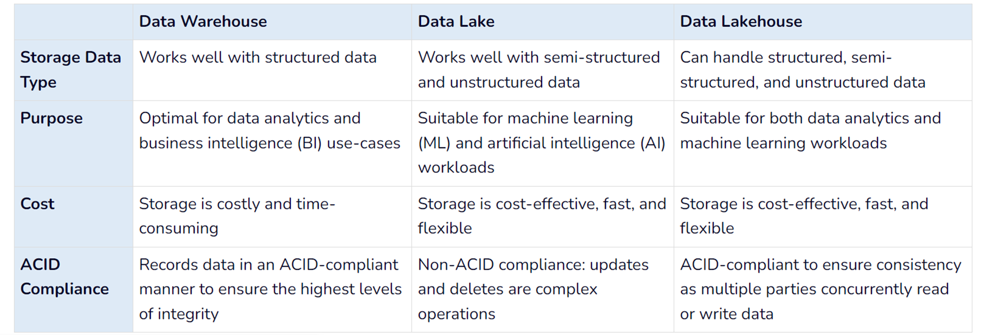
Day 3 – Azure SQL
•Hadoop is an open-source framework from Apache and is used to store process and analyze data which are very huge in volume. Hadoop is written in Java and is not OLAP (online analytical processing). It is used for batch/offline processing.

Slide 5
Day 3 – Azure sql
Modules of Hadoop
HDFS: Hadoop Distributed File System. Google published its paper GFS and on the basis of that HDFS was developed. It states that the files will be broken into blocks and stored in nodes over the distributed architecture.
Yarn: Yet another Resource Negotiator is used for job scheduling and manage the cluster.
Map Reduce: This is a framework which helps Java programs to do the parallel computation on data using key value pair. The Map task takes input data and converts it into a data set which can be computed in Key value pair. The output of Map task is consumed by reduce task and then the out of reducer gives the desired result.
Hadoop Common: These Java libraries are used to start Hadoop and are used by other Hadoop modules.
Azure Blob Storage is a highly scalable and efficient cloud storage solution designed for storing and retrieving large amounts of unstructured data, such as documents, images, and videos.

Slide 6
Day 4 – Azure storage
Azure Storage is a cloud-based storage solution provided by Microsoft Azure. It offers a range of different storage options to meet the needs of various applications and workloads.
Worked on sql commands:
select * from emp
select * from emp where sal between 2000 and 3000
select * from emp where sal not between 2000 and 3000
select * from emp where ename like 's%'
select * from emp where comm is not null
select ename, len(ename) from emp
select ASCII('B')
select ename, concat('Hi ',ename) as ename1 from emp
select ename, right(ename,3) from emp;
select ename, substring(ename,2,2) from emp;
select charindex('sql','i love sql')
select Nullif(ename,'smith') as ename_0 from emp
select sal,iif(sal>3000,'good sal',iif(sal>2000,'avg sal','poor')) sal_desc from emp
select empno,ename,sal, rank() over(order by sal) as sal_rank from emp

Slide 7
select empno,ename,sal,deptno,dense_rank() over(partition by deptno order by sal desc) as deptrank from emp
select row_number() over(order by empno) as slno,empno,ename from emp
select row_number() over(partition by deptno) as slno,empno, ename from emp
select * from emp
select * from dept
insert into emp values(1,'akshay','it',7902,getdate(),4000,0,70);
insert into dept values(60,'marketing','chennai')
insert into dept values(40,'Operation','Boston')
select sal from emp where ename='SMITH'
select * from emp where sal>(select sal from emp where ename='smith')
select ename from emp where sal>(select avg(sal) from emp)
select ename from emp where sal = (select maX(sal) from emp)
select * from dept where deptno not in (select distinct deptno from emp)
select * from emp o where sal>(select avg(sal) from emp i where o.deptno=i.deptno);
select dname,sum(sal) as sum_sal, max(sal) as max_sal, avg(sal) as avg_sal, count(sal) as noofrecords from emp e join dept d on e.deptno=d.deptno group by dname

